Slide 1


BOOTSTRAP
Lecture-12

Slide 2
Today’s Agenda
BootStrap Inputs
Text Input
Setting Sizes
Adding Hep Text
Input States
Input Groups
Custom Controls

Slide 3
BootStrap Inputs
Now lets discuss about more Bootstrap 4 form elements.
We have already covered buttons so now we will go through Bootstrap 4 text inputs and custom inputs like checkboxes, radio buttons and select pickers.

Slide 4
Text Input
The inputs that are created for text are <input> and <textarea>.
They both need the .form-control class to get the Bootstrap 4 inputs look

Slide 5
Example
<div class="container">
<div class="row">
<div class="col-8">
<label for="input1">Email address</label>
<input type="email" class="form-control mb-3" id="input1" placeholder="name@example.com">
<label for="textarea1">Your Description</label>
<textarea class="form-control" id="textarea1" rows="3" placeholder="Write your story here..."></textarea>
</div>
</div>
</div>

Slide 6
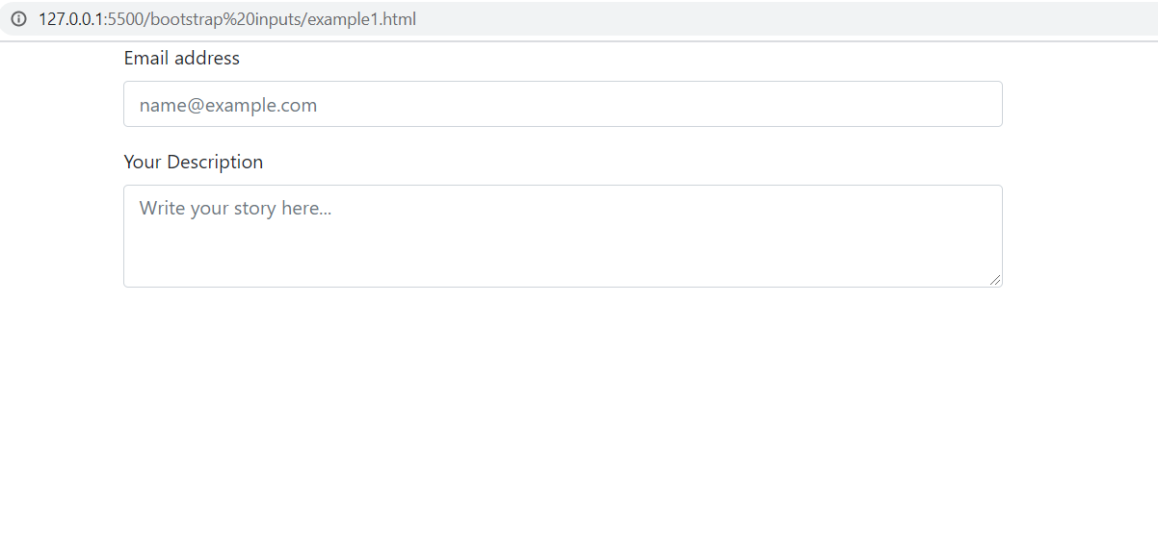
Output

Slide 7
Setting Sizes
We can modify the dimensions of the text inside the inputs and their height with the classes .form-control-sm for a smaller input and .form-control-lg for a bigger input.

Slide 8
Example
<div class="container">
<div class="row">
<div class="col-8">
<input class="form-control form-control-sm mb-3" type="text" placeholder="Small input">
<input class="form-control mb-3" type="text" placeholder="Default input">
<input class="form-control form-control-lg mb-3" type="text" placeholder="Large input">
</div>
</div>
</div>

Slide 9
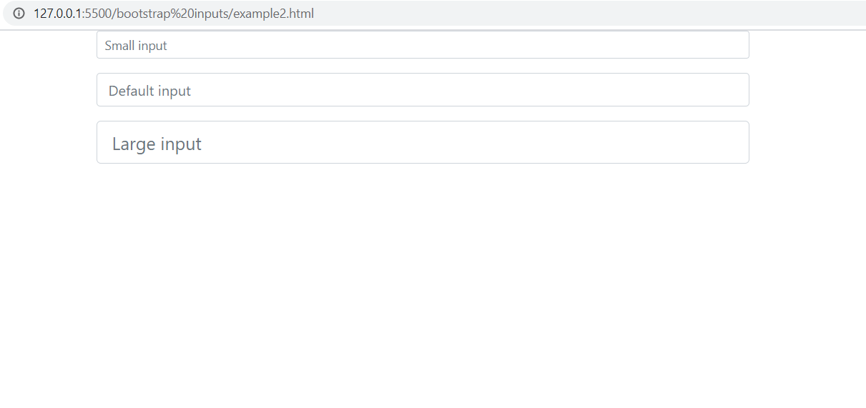
Output

Slide 10
Adding Help Text
We can add an explanation to our input with a block of text next to it.
Bootstrap 4 has a special class for this called .form-text.
This makes the element it is used with a block and adds a top margin.

Slide 11
Adding Help Text
We can use this class with tags such as <small>, <span> or <p>.
If we want to change how the help block looks, we can use the text utilities given by Bootstrap 4 typography.

Slide 12
Example
<div class="container">
<div class="row">
<div class="col-8">
<label for="inputPassword">Password</label>
<input type="password" id="inputPassword" class="form-control" aria-describedby="passwordHelpBlock">
<small id="passwordHelpBlock" class="form-text text-info">
Your password must be 8-20 characters long, contain letters and numbers, and must not contain spaces, special characters, or emoji.
</small>
</div>
</div>
</div>

Slide 13
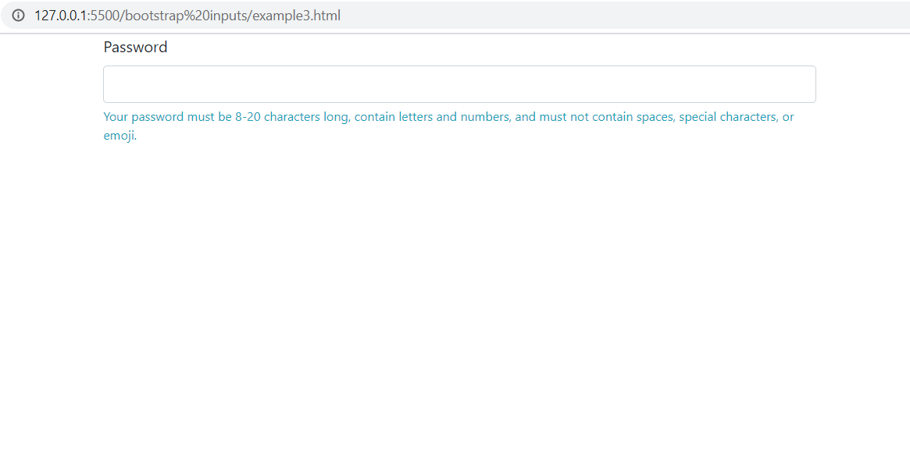
Output

Slide 14
Input State-Disabled
To prevent user interactions for an input, we can add the disabled attribute.
It will appear lighter and won’t take any input.

Slide 15
Example
<div class="container">
<div class="row">
<div class="col-8">
<input class="form-control mb-3" type="text" placeholder="This is a disabled input." disabled>
</div>
</div>
</div>

Slide 16
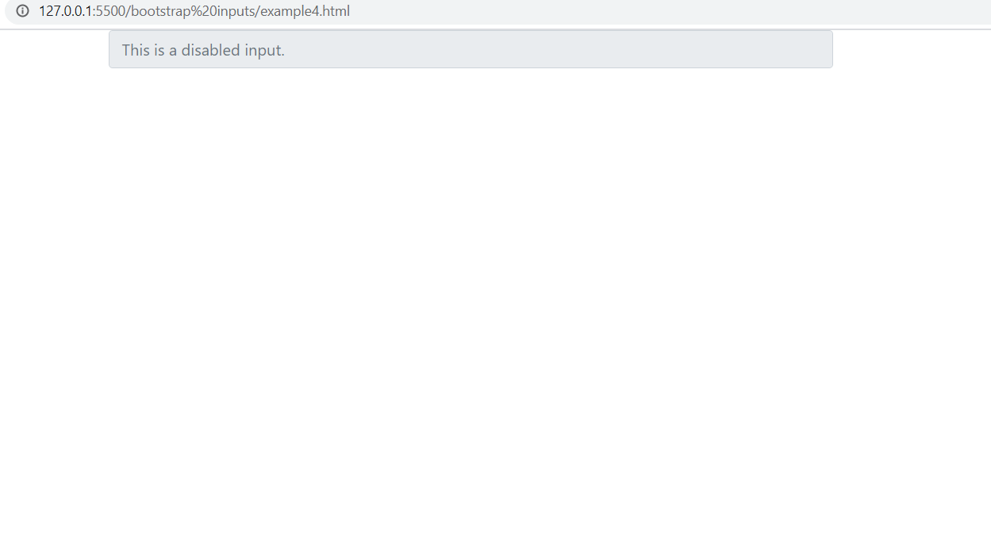
Output

Slide 17
Input State-Read Only
We can disable an input with the readonly attribute too.
The difference between disabled and readonly is that the readonly inputs retain the focus.

Slide 18
Example
<div class="container">
<div class="row">
<div class="col-8">
<input class="form-control mb-3" type="text" placeholder="This is a readonly input." readonly>
</div>
</div>
</div>

Slide 19
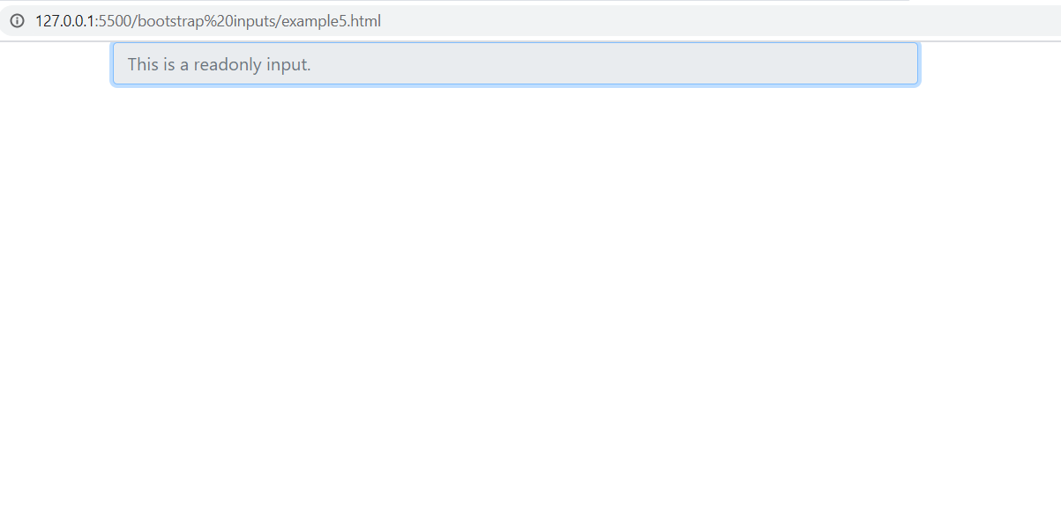
Output

Slide 20
BootStrap 4-Input Groups
We can extend an input by adding an add-on on either side.
An add-on is a text, icon or button that helps the user understand the use of the input

Slide 21
Basic Input Group
To create an input group we need an element with the .input-group class that holds both the .form-control and the add-on.
If we want to place the add-on before the input, we need to use the .input-group-prepend class.

Slide 22
Basic Input Group
And if we want the add-on after the input, we need to use the .input-group-append class.
The input can be a text input, a textarea, a custom select or a file upload..

Slide 23
Basic Input Group
And if we want the add-on after the input, we need to use the .input-group-append class.
The input can be a text input, a textarea, a custom select or a file upload..

Slide 24
Example
<div class="input-group mb-3">
<div class="input-group-prepend">
<span class="input-group-text" id="basic-addon1">@</span>
</div>
<input type="text" class="form-control" placeholder="Username" aria-label="Username" aria-describedby="basic-addon1">
</div>
<div class="input-group mb-3">
<input type="text" class="form-control" placeholder="Recipient's username" aria-label="Recipient's username" aria-describedby="basic-addon2">
<div class="input-group-append">
<span class="input-group-text" id="basic-addon2">@example.com</span>
</div>
</div>

Slide 25
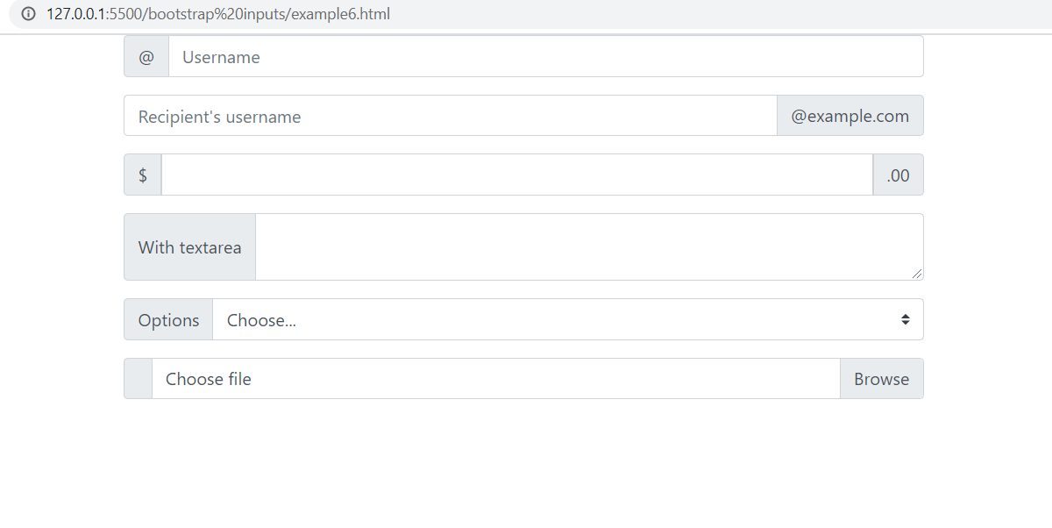
Output

Slide 26
Button Add On
We can make the add-on an actionable button

Slide 27
Example
<div class="col-8">
<div class="input-group mb-3">
<input type="text" class="form-control" placeholder="Recipient's username" aria-describedby="button-addon2">
<div class="input-group-append">
<button class="btn btn-info" type="button" id="button-addon2">Subscribe</button>
</div>
</div>
</div>

Slide 28
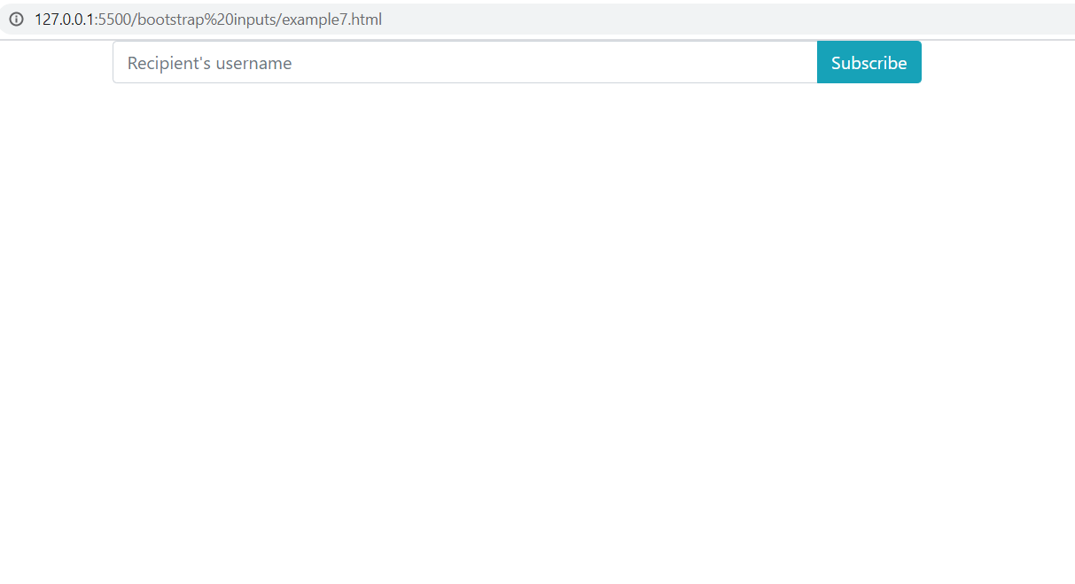
Output

Slide 29
Multiple Add On
An input group can have multiple inputs and multiple add-ons.
By placing the elements in the same .input-group div, they will be glued together.

Slide 30
Example
<div class="container">
<div class="row">
<div class="col-8">
<div class="input-group mb-3">
<div class="input-group-prepend">
<span class="input-group-text">First and last name</span>
</div>
<input type="text" aria-label="First name" class="form-control">
<input type="text" aria-label="Last name" class="form-control">
</div>
<div class="input-group mb-3">
<input type="text" class="form-control" aria-label="Dollar amount (with dot and two decimal places)">
<div class="input-group-append">
<span class="input-group-text">$</span>
<span class="input-group-text">0.00</span>
</div>
</div>
</div>
</div>
</div>

Slide 31
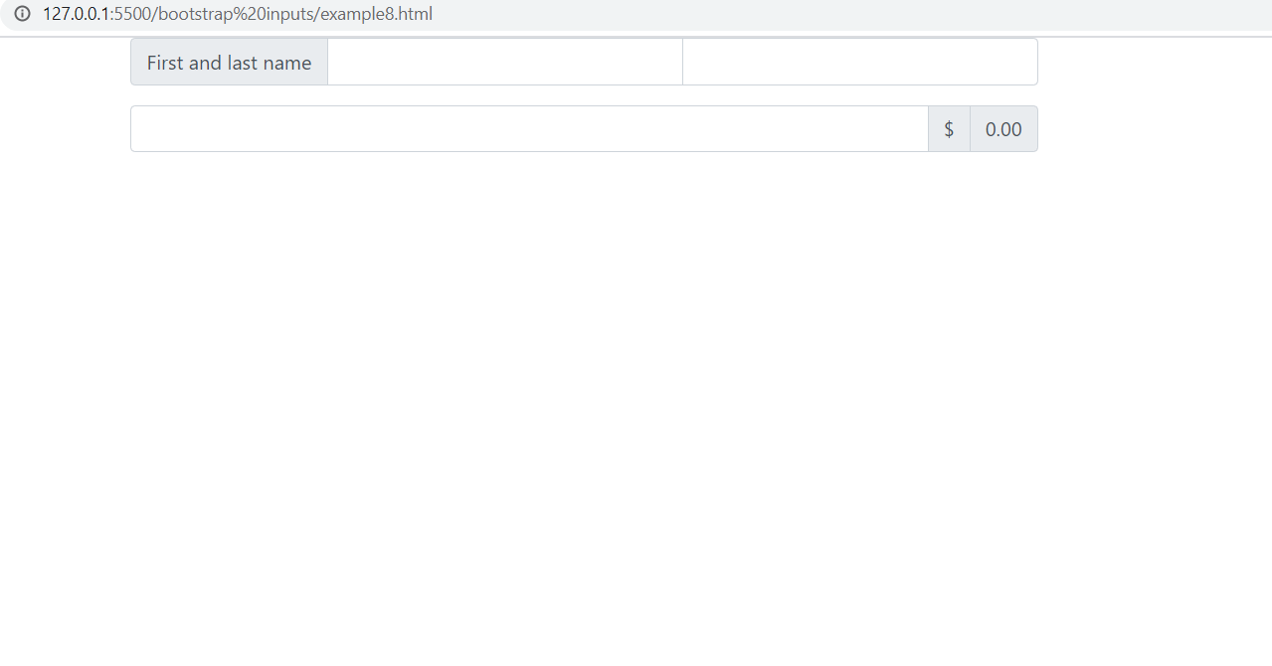
Output

Slide 32
Setting Sizes
If we want to size an input group, we need to add a sizing class on the input group and the inputs will automatically resize.
Sizing the inputs and add-ons individually is not supported.

Slide 33
Setting Sizes
There are 3 size options: the default one (no extra class added), the small one with the class .input-group-sm and the large one with the class .input-group-lg.

Slide 34
Example
<div class="input-group input-group-sm mb-3">
<div class="input-group-prepend">
<span class="input-group-text" id="inputGroup-sizing-sm">Small</span>
</div>
<input type="text" class="form-control" aria-label="Sizing example input" aria-describedby="inputGroup-sizing-sm">
</div>
<div class="input-group mb-3">
<div class="input-group-prepend">
<span class="input-group-text" id="inputGroup-sizing-default">Default</span>
</div>
<input type="text" class="form-control" aria-label="Sizing example input" aria-describedby="inputGroup-sizing-default">
</div>
<div class="input-group input-group-lg mb-3">
<div class="input-group-prepend">
<span class="input-group-text" id="inputGroup-sizing-lg">Large</span>
</div>
<input type="text" class="form-control" aria-label="Sizing example input" aria-describedby="inputGroup-sizing-lg">
</div>

Slide 35
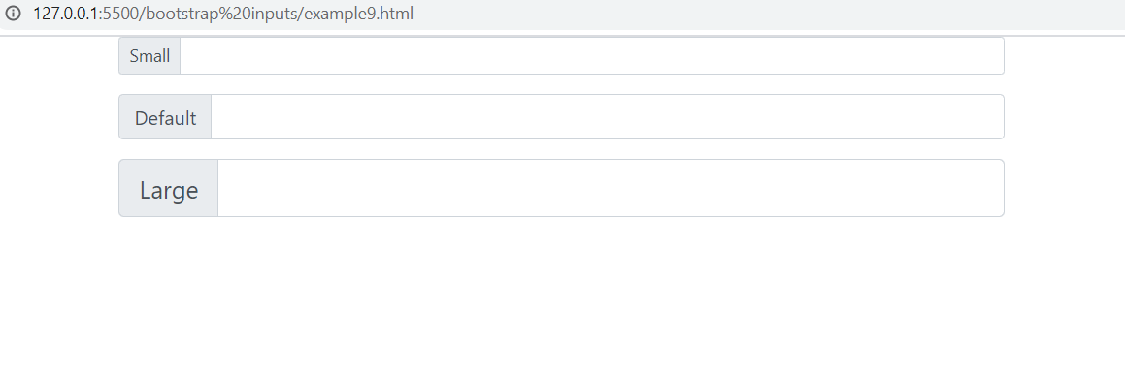
Output

Slide 36
BootStrap 4 Custom Inputs
Bootstrap 4 has classes for custom inputs: checkboxes, radios and select pickers.
The default checkboxes and radios can be overwritten by the Bootstrap 4 classes.

Slide 37
BootStrap 4 Custom Inputs
There are 2 options both for checkboxes and radios: the default version and the custom one.
The custom version looks better than the default version, so its recommended using this version

Slide 38
Stacked CheckBox
To get the custom Bootstrap 4 style for checkboxes we need to use the .custom-control class together with the .custom-checkbox class.
Inside the .custom-checkbox element we will need .custom-control-input and the .custom-control-label.
If we are using multiple checkboxes, they will be vertically stacked and aligned.

Slide 39
Example
<div class="custom-control custom-checkbox">
<input type="checkbox" class="custom-control-input" id="customCheck1" checked>
<label class="custom-control-label" for="customCheck1">You can check this first option</label>
</div>
<div class="custom-control custom-checkbox">
<input type="checkbox" class="custom-control-input" id="customCheck2">
<label class="custom-control-label" for="customCheck2">And you can also check this second option</label>
</div>

Slide 40
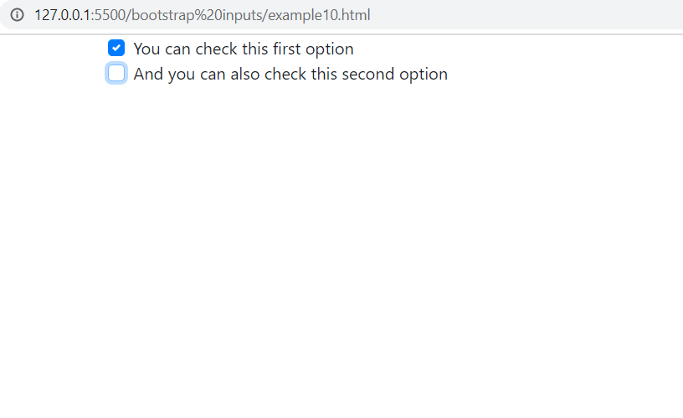
Output

Slide 41
Disabled CheckBox
If we want to prevent all user interactions with a checkbox, we need to add the disabled attribute on the .form-check-input.

Slide 42
Example
<div class="container">
<div class="row">
<div class="col-8">
<div class="custom-control custom-checkbox">
<input class="custom-control-input" type="checkbox" value="" id="disabledCheck" disabled>
<label class="custom-control-label" for="disabledCheck">
You can't check this.
</label>
</div>
</div>
</div>
</div>

Slide 43
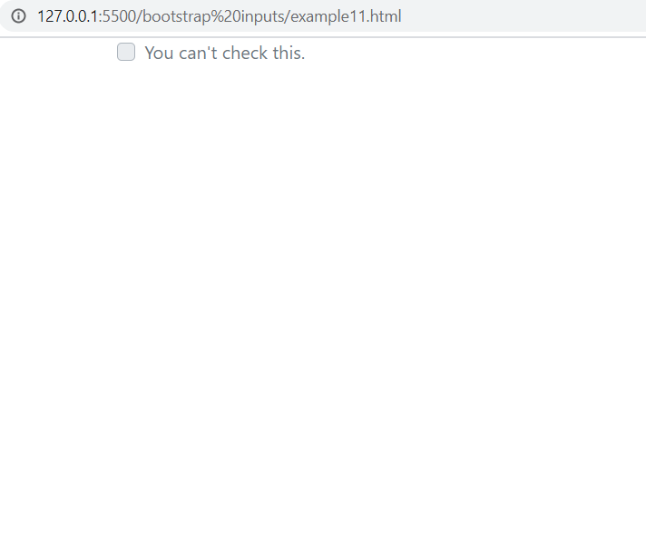
Output

Slide 44
Stacked RadioButton
To use the custom radio, we need to use the base .custom-control class together with the .custom-radio class.
The input needs the .custom-control-input class and the label the .custom-control-label class.
The radio buttons will appear stacked as a default behaviour

Slide 45
Example
<div class="custom-control custom-radio">
<input type="radio" id="customRadio1" name="customRadio" class="custom-control-input" checked>
<label class="custom-control-label" for="customRadio1">Toggle the first option</label>
</div>
<div class="custom-control custom-radio">
<input type="radio" id="customRadio2" name="customRadio" class="custom-control-input">
<label class="custom-control-label" for="customRadio2">Or toggle the second option</label>
</div>

Slide 46
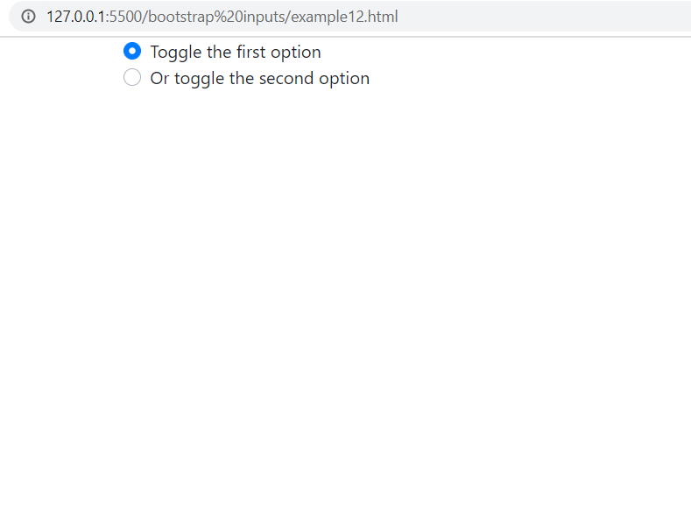
Output

Slide 47
Inline RadioButton
We can place the radio buttons inline if we add the .custom-control-inline to each .custom-control.

Slide 48
Example
<div class="container">
<div class="row">
<div class="col-8">
<div class="custom-control custom-radio custom-control-inline">
<input type="radio" id="customRadioInline1" name="customRadioInline1" class="custom-control-input">
<label class="custom-control-label" for="customRadioInline1">Toggle this first option</label>
</div>
<div class="custom-control custom-radio custom-control-inline">
<input type="radio" id="customRadioInline2" name="customRadioInline1" class="custom-control-input">
<label class="custom-control-label" for="customRadioInline2">Or toggle this second option</label>
</div>
</div>
</div>
</div>

Slide 49
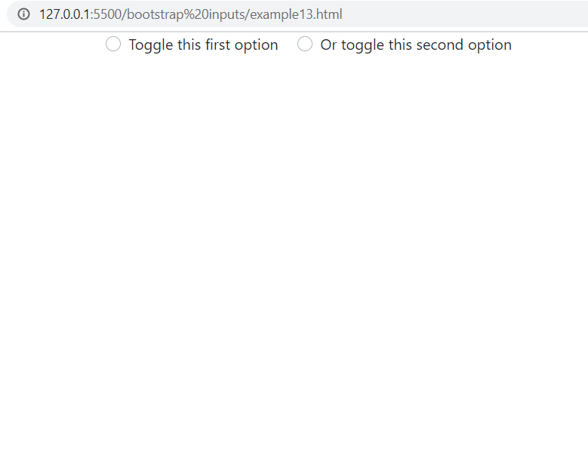
Output

Slide 50
Disabled RadioButton
If we want to prevent all user interactions with a radio button, we need to add the disabled attribute on the . .custom-control-input.

Slide 51
Example
<div class="custom-control custom-radio">
<input type="radio" id="radio3" name="radioDisabled" id="customRadioDisabled" class="custom-control-input" disabled>
<label class="custom-control-label" for="customRadioDisabled">Toggle this custom radio</label>
</div>

Slide 52
Output

Slide 53
Select Picker
To change the style of a select picker from the default browser style to the Bootstrap 4 style, we need to add the .custom-select class.

Slide 54
Example
<div class="container">
<div class="row">
<div class="col-8">
<select class="custom-select">
<option selected>This is a select menu</option>
<option value="1">Option 1</option>
<option value="2">Option 2</option>
<option value="3">Option 3</option>
</select>
</div>
</div>
</div>

Slide 55
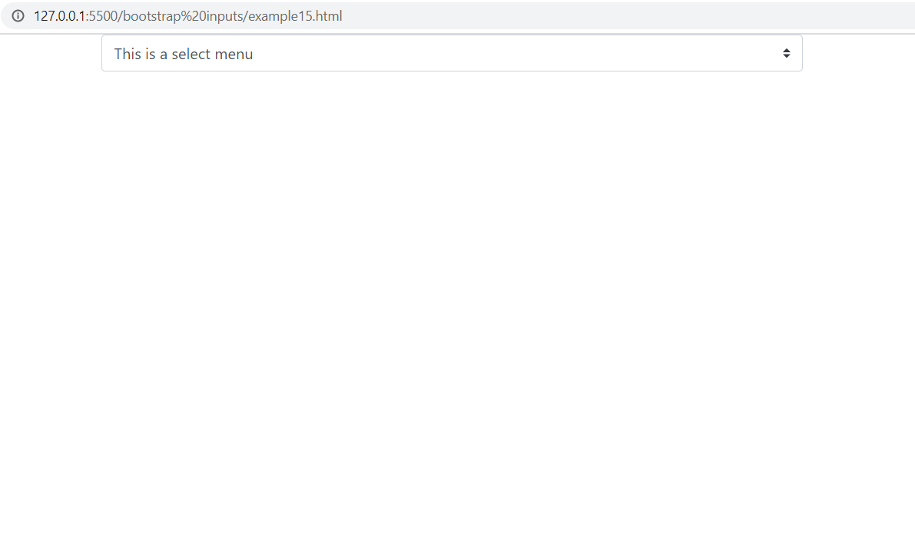
Output

